Slide 1

Finding the Optimal K in K-Nearest Neighbors and K-Means Algorithms
K-Nearest Neighbors (KNN)
K-Means Clustering
By : Ahmed Elgohary

Slide 2
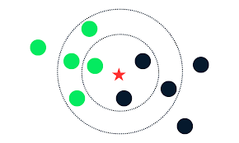
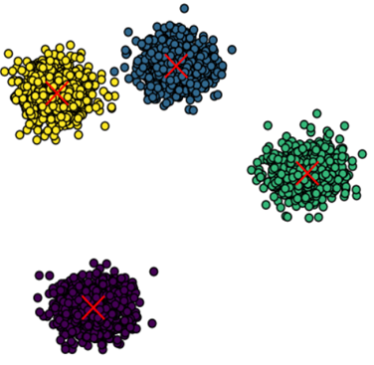
Introduction
Goals of the Presentation:
Explain Methods:
How to choose the optimal number of neighbors for KNN.
How to determine the optimal number of clusters for K-Means.
Provide Practical Insights:
Techniques for evaluating and selecting the best K for both algorithms.
Visualize Results:
Use of plots and examples to illustrate the methods.
Overview of Algorithms:
K-Nearest Neighbors (KNN):
A classification and regression algorithm that predicts the output based on the K closest data points in the feature space.
Utilizes distance metrics to determine similarity.
K-Means Clustering:
A popular clustering algorithm used to partition a dataset into K distinct clusters based on feature similarity.
Aims to minimize the variance within each cluster.
Importance of Selecting Optimal K:
For KNN:
The choice of K influences the model’s complexity and generalization ability.
Too small K can lead to overfitting, while too large K may cause underfitting.
For K-Means:
The choice of K directly affects the clustering results and interpretation.
Incorrect K can lead to poor clustering performance and misleading results.

Slide 3
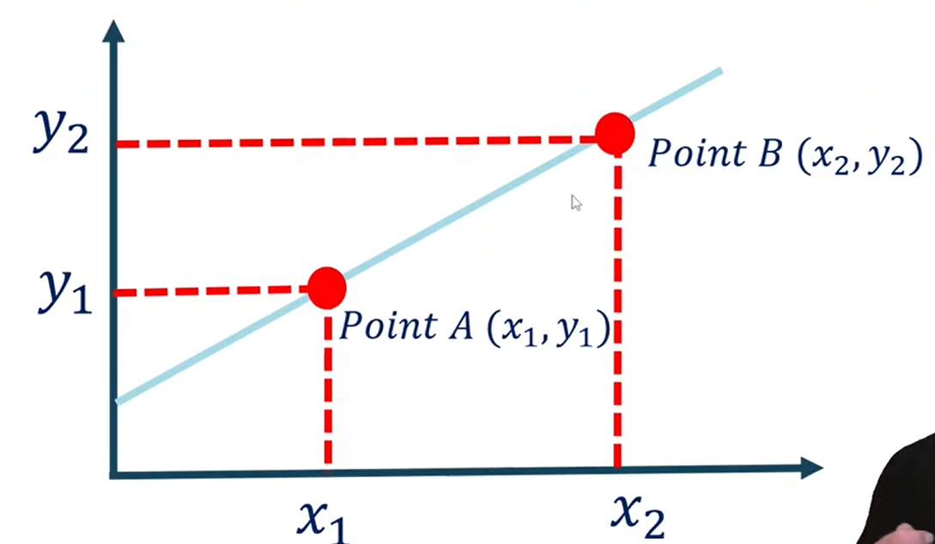

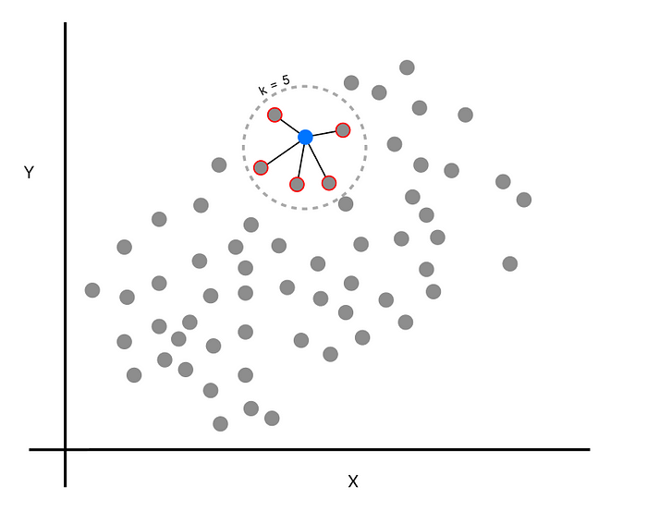
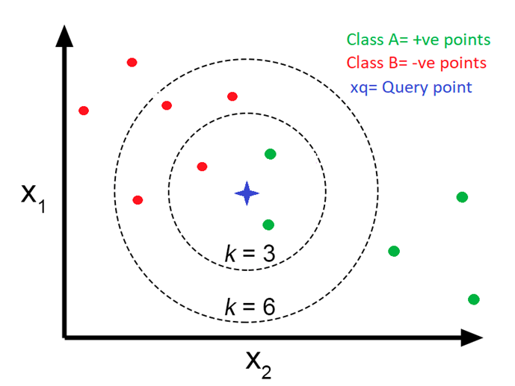





K-Nearest Neighbors (KNN)
KEY TERMS
Neighbors: The K closest points to the query point.
Distance Metric: A measure of similarity or dissimilarity (e.g., Euclidean distance, Manhattan distance).
K-Nearest Neighbors (KNN) is a non-parametric a supervised algorithm,
instance-based learning algorithm used for classification and regression tasks.
It makes predictions based on the K closest data points in the feature space.
Classification
The class label of a data point is determined by the majority vote of its K nearest neighbors.
Regression
The prediction is the average (or weighted average) of the values of its K nearest neighbors.
How KNN Works
Choose the Number of Neighbors (K)
Calculate Euclidean Distance
Identify Nearest Neighbors
Count Data Points in Each Category
Assign to the Majority Category
Advantages:
Simple to understand and implement.
No training phase; the model is built at the time of prediction.
Disadvantages:
Computationally expensive during prediction, especially with large datasets.
Performance can degrade with high-dimensional data (curse of dimensionality)..

Slide 4
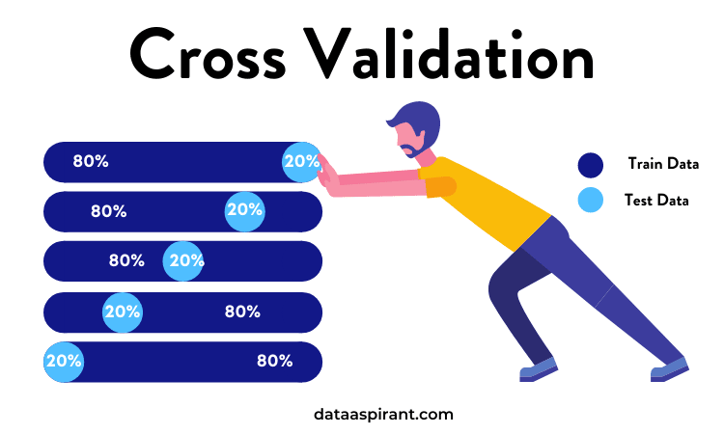
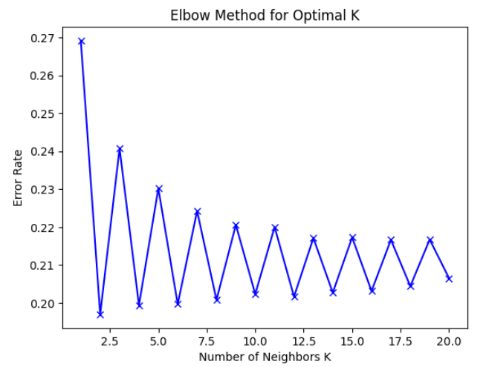
Methods to Find Optimal K for KNN
from sklearn.model_selection import cross_val_score
from sklearn.neighbors import KNeighborsClassifier
import numpy as np
k_values = range(1, 21)
scores = []
for k in k_values:
knn = KNeighborsClassifier(n_neighbors=k)
cv_scores = cross_val_score(knn, X, y, cv=5, scoring='accuracy') # 5-fold cross-validation
scores.append(cv_scores.mean())
optimal_k = k_values[np.argmax(scores)]
print(f"The optimal K for KNN is {optimal_k}")
1 - Cross-Validation
Split dataset into training and validation sets
Evaluate performance for different K values
Select K with best performance
k_values = range(1, 21)
error_rates = []
# Loop through the K values to evaluate performance
for k in k_values:
knn = KNeighborsClassifier(n_neighbors=k)
knn.fit(x_train_selected, y_train_balanced)
y_pred = knn.predict(x_test_selected)
error_rate = 1 - accuracy_score(y_test, y_pred)
error_rates.append(error_rate)
# Plot the error rates against K values
plt.plot(k_values, error_rates, 'bx-')
plt.xlabel('Number of Neighbors K')
plt.ylabel('Error Rate')
plt.title('Elbow Method for Optimal K')
plt.show()
2 - Elbow Method
Select a Range of 𝐾 Values.
Calculate Error Rates for Each 𝐾.
Plot Error Rates Against 𝐾.
Identify the Elbow Point.

Slide 5
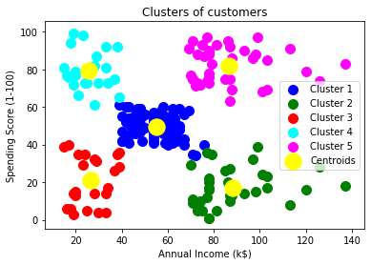




K-Means Clustering
K-Means is a popular unsupervised machine learning algorithm
used for clustering data. It aims to partition a dataset into K distinct,
non-overlapping subgroups(or clusters)
where each data point belongs to the cluster with the nearest mean.
The Algorithm works as follows:
First, we randomly initialize k points, called means or cluster centroids.
We categorize each item to its closest mean, and we update the mean’s coordinates, which are the averages of the items categorized in that cluster so far.
We repeat the process for a given number of iterations and at the end, we have our clusters.

Slide 6
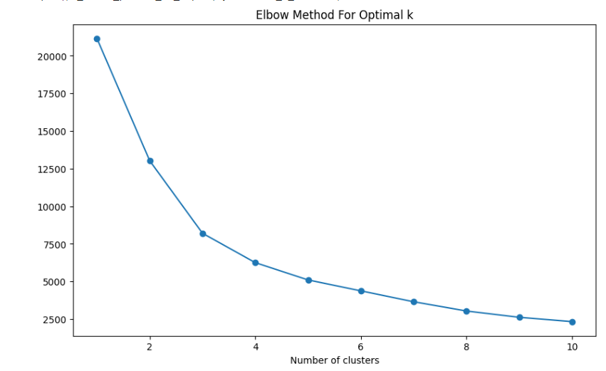
1 - Elbow Method
Compute the K-Means algorithm for different values of k (e.g., 1 to 10).
For each k, calculate the sum of squared distances (inertia).
Plot the inertia against the number of clusters k.
The "elbow" point on the plot suggests the optimal k.
inertia = []
range_clusters = range(1, 11)
# Calculate inertia for each number of clusters
for k in range_clusters:
kmeans = KMeans(n_clusters=k, random_state=42)
kmeans.fit(X_scaled)
inertia.append(kmeans.inertia_)
# Plot the Elbow graph
plt.figure(figsize=(10, 6))
plt.plot(range_clusters, inertia, marker='o')
plt.xlabel('Number of clusters')
plt.ylabel('Inertia')
plt.title('Elbow Method For Optimal k')
plt.show()
from sklearn.metrics import silhouette_score
range_clusters = range(2, 11) # Start from 2 as silhouette is not defined for k=1
silhouette_avg = []
for k in range_clusters:
kmeans = KMeans(n_clusters=k, random_state=42)
cluster_labels = kmeans.fit_predict(features_no_outliers)
silhouette_avg.append(silhouette_score(features_no_outliers, cluster_labels))
# Plot the Silhouette Method graph
plt.figure(figsize=(8, 6))
plt.plot(range_clusters, silhouette_avg, marker='o')
plt.xlabel('Number of clusters')
plt.ylabel('Silhouette Score')
plt.title('Silhouette Method For Optimal k')
plt.show()
2. Silhouette Method
Compute the K-Means algorithm for different values of k.
For each k, calculate the silhouette score.
Plot the silhouette scores for each k.
The k with the highest silhouette score is optimal.
Methods to Find Optimal K for K-Means

